Slide 1
1-D Heat Transfer Problem
Synchronous Communication

Slide 2
Heat Transfer Example Timing analysis with Synchronous Point-to-point Com Routines
If it is assumed that the total_points parameter is an even multiple of numprocs and that all floating point operations are of unit time weight, determine a general expression for the parallel execution time of the compute_temp function. This expression should be an algebraic function of the parameters numprocs, total_points, num_iterations, and the Tstartup, and Tdata components of the MPI point-to-point message passing routines. Assume that the buffer size for this implementation is so small that the both the MPI_Ssend and the MPI_Recv routines will always block until the entire message has been transferred. Also assume that the network that is being used supports simultaneous point-to-point transfers of data between distinct source and destination processor pairs (the very best case in this regard).

Slide 3
Synchronous Mode - Send and receive can start before each other but can only complete together.
Example: MPI_Ssend, MPI_Issend
Note: The send does not complete until after a matching receive has been posted

Slide 4
1-D Heat Transfer Problem
Synchronous Message Passing Implementation of exchange operations
Sends should be paired with receives to insure safe operation
Adheres to Communicating Serial Processes Paradigm
A Performance Model can be created most easily

Slide 5
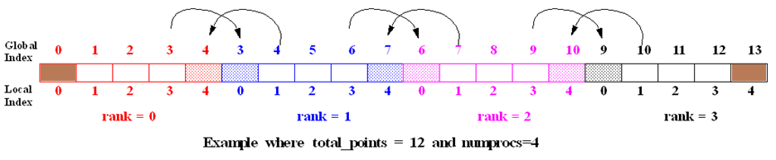
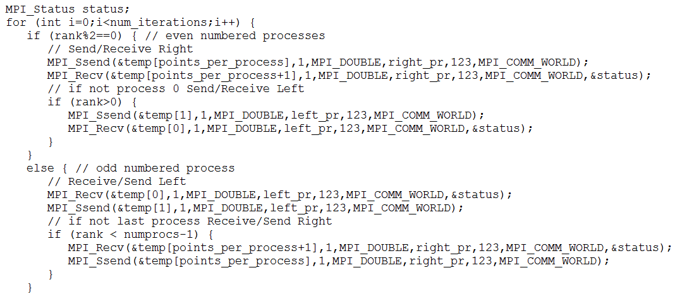

Slide 6
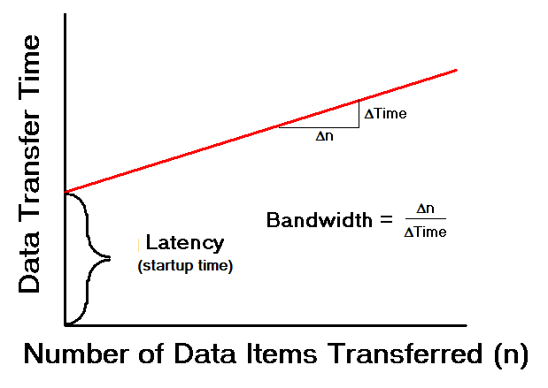



Idealized Communication Time
1.6

Slide 7
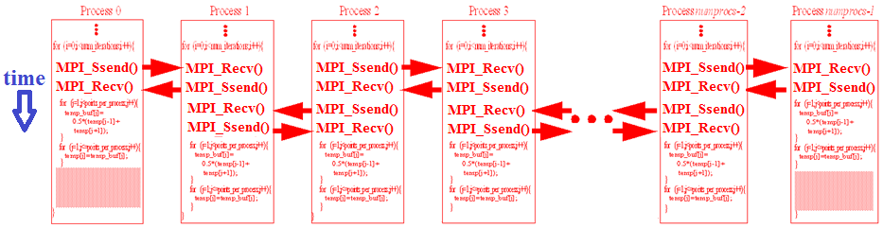
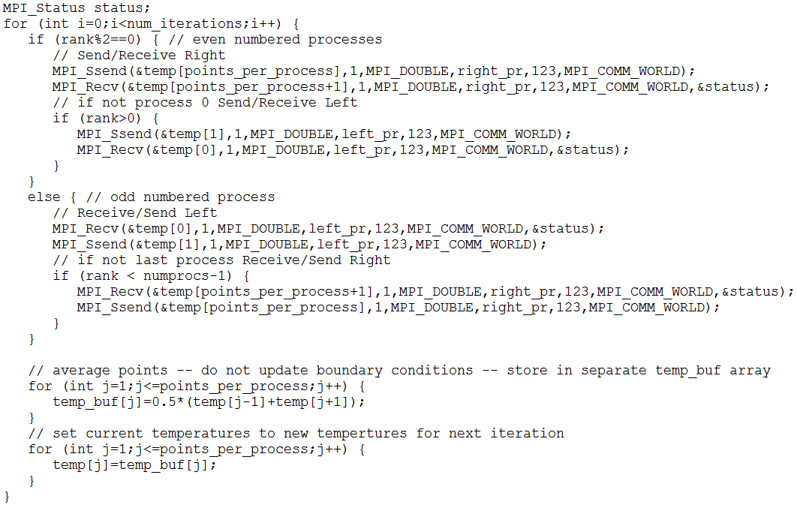

Slide 8
